Slide 1
Intel® Threading Building Blocks
(Intel® TBB)
July 20, 2009
Arch D. Robison
Sr. Principal Engineer
Performance Analysis and Threading (PAT)
Software and Services Group (SSG),
Intel Corporation, Champaign IL

Slide 2
Two Quotes Related to Parallel Programming
“Many hands make light work.”
“When robots threaten to take over the world, we will organize them into committees.”

Slide 3

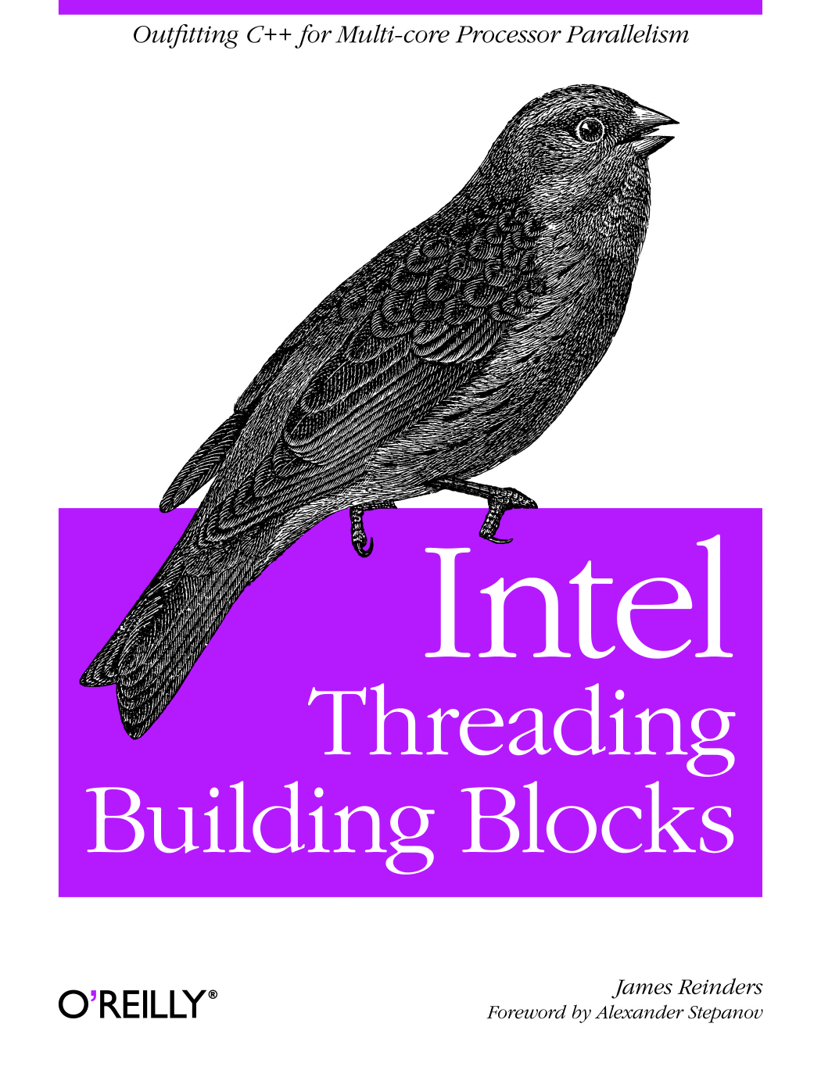
Overview of Intel® TBB
Intel® Threading Building Blocks (Intel® TBB) is a C++ library that simplifies threading for performance
Move the level at which you program from threads to logical parallelism.
Let the run-time library worry about how many threads to use, scheduling, cache etc.
Committed to:
compiler independence
processor independence
OS independence
GPL license allows use on many platforms; commercial license allows use in products
http://www.threadingbuildingblocks.org/

Slide 4
Outline
Why threads are bad for parallel programming
Review of C++
  TBBLab/lambda/
How to set TBB macros for debugging / tuning / production code
Algorithm templates
  TBBLab/parallel_for/
  Mutexes and atomic ops
Task group
  TBBLab/task_group/
Concurrent containers
  TBBLab/concurrent_hash_map

Slide 5
Problem
Gaining performance from multi-core requires parallel programming
Even a simple “parallel for” is tricky for a non-expert to write well with threads.
Two aspects to parallel programming
  Correctness: avoiding race conditions and deadlock
  Performance: efficient use of resources
    Hardware threads (match parallelism to hardware threads)
    Memory space (choose right evaluation order)
    Memory bandwidth (reuse cache)

Slide 6
Threads are Unstructured
pthread_t id[N_THREAD];
for(int i=0; i<N_THREAD; i++) {
int ret = pthread_create(&id[i], NULL, thread_routine, (void*)i);
assert(ret==0);
}
for( int i = 0; i < N_THREAD; i++ ) {
int ret = pthread_join(id[i], NULL);
assert(ret==0);
}
parallel goto
parallel comefrom
unscalable too!
Notes:
Unscalable because of O(N_THREAD) startup time.

Slide 7
Registers
Level 1 Instr. Cache
Level 1 Data Cache
Level 2 Shared Cache
Area ∝ bytes
Off chip memory is slow.
Cache behavior matters!
Latency ∝ length of arrow Bandwidth ∝ width of arrow
Main Memory
(Would be 16x4 feet if 2 GB were drawn to paper scale)

Slide 8
Sieve of Eratosthenes for Finding Primes
Start with odd integers
3
5
7
9
11
13
15
17
19
21
23
25
27
29
31
33
35
37
39
Strike out odd multiples of 3
Strike out odd multiples of 5
Strike out odd multiples of 7
...

Slide 9
Running Out of Cache
Strike out odd multiples of k
cache
Each pass through array has to reload from cache!

Slide 10
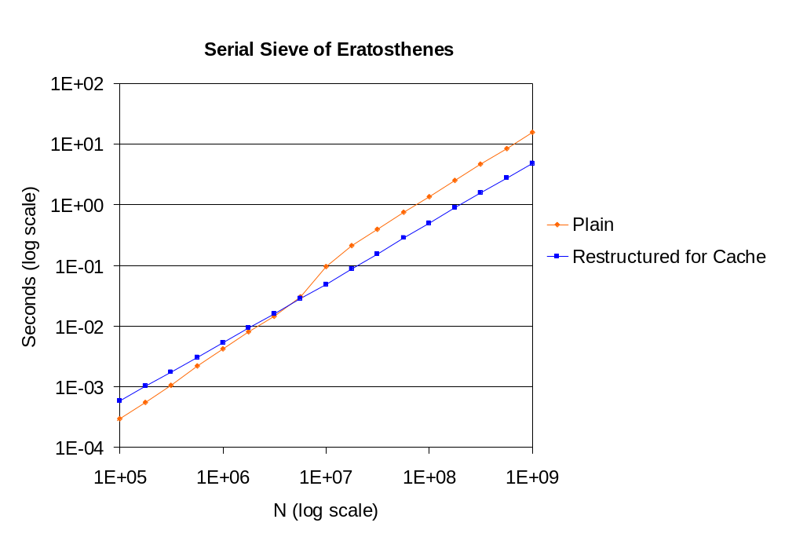
Optimizing for Cache Is Critical
Optimizing for cache can beat small-scale parallelism
3.3x improvement!
Performance tests and ratings are measured using specific computer systems and/or components and reflect the approximate performance of Intel products as measured by those tests. Any difference in system hardware or software design or configuration may affect actual performance. Buyers should consult other sources of information to evaluate the performance of systems or components they are considering purchasing. For more information on performance tests and on the performance of Intel products, visit Intel Performance Benchmark Limitations
~/tbb/examples/parallel_reduce/primes/primes.cpp
has version that is restructured and parallel.
Notes:
Download library to see parallel version.
STREAM benchmark

Slide 11
One More Problem: Nested Parallelism
Software components are built from smaller components
If each turtle specifies threads...

Slide 12
Summary of Problem
Gaining performance from multi-core requires parallel programming
Two aspects to parallel programming
  Correctness: avoiding race conditions and deadlock
  Performance: efficient use of resources
    Hardware threads (match parallelism to hardware threads)
    Memory space (choose right evaluation order)
    Memory bandwidth (reuse cache)

Slide 13
Family Tree
1988
Chare Kernel
small tasks
Languages
Threaded-C
continuation tasks
task stealing
STL
generic programming
1995
Cilk
space efficient scheduler
cache-oblivious algorithms
Pragmas
OpenMP*
fork/join tasks
Libraries
OpenMP taskqueue
while & recursion
JSR-166
(FJTask)
containers
STAPL
recursive ranges
2001
ECMA .NET*
parallel iteration classes
2006
Intel® TBB
*Other names and brands may be claimed as the property of others
Notes:
1988 Chare Kernel [UIUC]
1994 PCM (run-time support for Threaded-C) [MIT]
1994 STL [HP]
1995 Cilk [MIT]
1997 OpenMP [consortium]
1998 OpenMP Taskqueue [KAI]
1999 FJTask [Doug Lea]
2001 STAPL [Texas A&M]
2004 ECMA parallel profile [Intel]
2005 TBB [Intel]
Other systems studied but not really influential
NESL [CMU] Requires major compiler support
StreamIt [MIT] Requires compiler support.
PSTL [Indiana]
Linda [Yale] Probably requries compiler support to be practical, but question is still open.

Slide 14
C++ Review
“Give me six hours to chop down a tree and I will spend the first four sharpening the axe.”
- Abraham Lincoln
Notes:
We’ll spend about 1/5 of our slides on the review.

Slide 15
C++ Review: Half Open Intervals
STL usually specifies sequence as half-open interval [first,last)
  first==last ⇔ empty interval
  last−first is size of interval
If object x contains a sequence
  x.begin() denotes first element (or pointer to first element).
  x.end() denotes “one past last” element.
Example
void PrintContainerOfTypeX( const X& x ) {
for( X::iterator i=x.begin(); i!=x.end(); ++i )
cout << *i << endl;
}
Notes:
Give me six hours to chop down a tree and I will spend the first four sharpening the axe. - Abraham Lincoln

Slide 16
C++ Review: Function Template
Type-parameterized function.
  Strongly typed.
  Obeys scope rules.
  Actual arguments evaluated exactly once.
  Not redundantly instantiated.
template<typename T>
void swap( T& x, T& y ) {
T z = x;
x = y;
y = z;
}
[first,last) define half-open interval
void reverse( float* first, float* last ) {
while( first<last-1 )
swap( *first++, *--last );
}
Compiler instantiates template swap with T=float.

Slide 17
Genericity of swap
template<typename T>
void swap( T& x, T& y ) {
T z = x;
x = y;
y = z;
}
// Construct z
// Assignment
// Assignment
// Destroy z
Requirements for T
T(const T&) | Copy constructor
void T::operator=(const T&); | Assignment
~T() | Destructor
Notes:
The ParallelSort in the library uses parallel_for.

Slide 18
C++ Review: Template Class
Type-parameterized class
template<typename T, typename U>
class pair {
public:
T first;
U second;
pair( const T& x, const U& y ) : first(x), second(y) {}
};
pair<string,int> x;
x.first = “abc”;
x.second = 42;
Compiler instantiates template pair with T=string and U=int.

Slide 19
C++ Function Object
Also called a “functor”
Is object with member operator().
class LinearOp {
float a, b;
public:
float operator() ( float x ) const {return a*x+b;}
Linear( float a_, float b_ ) : a(a_), b(b_) {}
};
LinearOp f(2,5);
y = f(3);
Could write this line as
y = f.operator()(3);

Slide 20
Template Function + Functor = Flow Control
template<typename I, typename Functor>
void ForEach( I lower, I upper, const Functor& f ) {
for( I i=lower; i<upper; ++i )
f(i);
}
Template function for iteration
class Accumulate {
float& acc;
float* src;
public:
Accumulate( float& acc_, float* src_ ) : acc(acc_), src(src_) {}
void operator()( int i ) const {acc += src[i];}
};
Functor
float Example() {
float a[4] = {1,3,9,27};
float sum = 0;
ForEach( 0, 4, Accumulate(sum,a) );
return sum;
}
Pass functor to template function.

Slide 21
So Far
Abstract control structure as a template function.
Encapsulate block of code as a functor.
Template function and functor can be arbitrarily complex.

Slide 22
Outline
Why threads are bad for parallel programming
Review of C++
  TBBLab/lambda/
How to set TBB macros for debugging / tuning / production code
Algorithm templates
  TBBLab/parallel_for/
  Mutexes and atomic ops
Task group
  TBBLab/task_group/
Concurrent containers
  TBBLab/concurrent_hash_map

Slide 23


Slide 24
声明：
所有的版权属于原有公司，文件均来自公开渠道
此文件仅供学习使用，任何人不得进行以此为商业目的的行为
如有疑问，请立即删除
学习世界五百强和咨询公司PPT课程请访问如下网站搜索：“司马懿”
百度传课：司马懿PPT学校
https://www.chuanke.com
网易学堂：司马懿PPT学校
https://study.163.com
知乎： 司马懿PPT学校
https://www.zhiu.com

